Slide 1
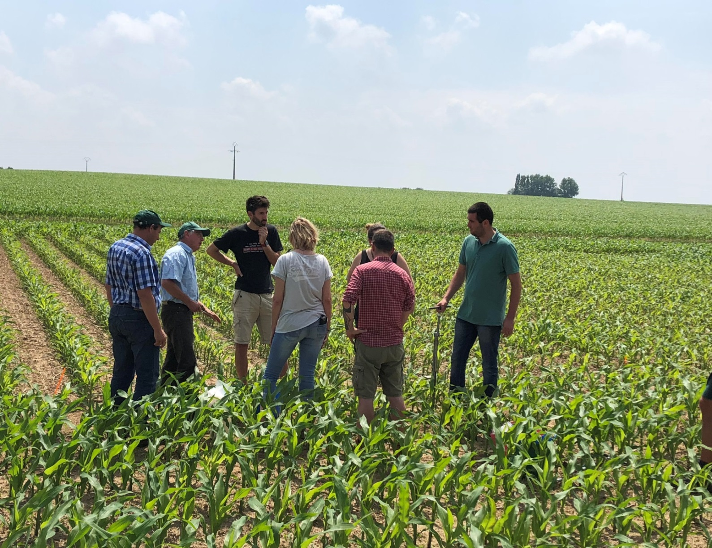
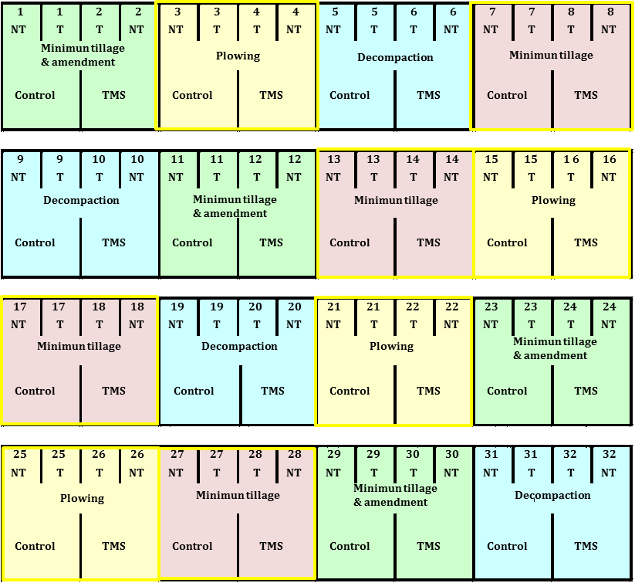




“Microbial communities are influenced by different soil management practices such as minimum tillage and plowing in historical field trials”
Bastien Durenne¹, Fabienne Delporte¹, Christian Roisin¹, Bruno Huyghebaert¹, Samuel Dequiedt², Pierre-Alain Maron², Julie Tripied³, Lionel Ranjard²
¹ Unité fertilité des sols et protection des eaux, Département agriculture et milieu naturel, Centre wallon de Recherches Agronomiques (CRA-W), 5030 Gembloux, Belgique.
² Agroécologie, AgroSup Dijon, Institut National de la Recherche Agronomique (INRA), Université Bourgogne Franche-Comté, F-21000 Dijon, France.
³ TMCE, Parc d’activités GOGAL Sud, 56920 St Gonnery France.
Context
Soil is probably one of the most complex environments on the Earth including a huge microbial diversity.
Microorganisms are largely involved in agricultural ecosystem functions and determined by
=> soil type, physical and chemical properties (pH, carbon content, texture…);
=> environmental conditions (temperature, humidity, land cover…).
The cropping system used over time is also a major factor (cover- and intercrops, fertilization).
Tillage management practices are also known to modulate the microbiome influencing the crops growth conditions.
Methodology
The soil microorganisms response to plowing and minimum tillage after long-term (15 years) field trials was investigated.
The factorial experimental design encompasses a mineral fertilization as third treatment (TMS®, a regulator of microbial activities and organic matter decomposition).
Soil samples were collected in June under maize crop and for two depths (0-10 and 15-25 cm).
After total DNA extraction, the molecular microbial biomass (MMB) was determined (µg of DNA . g¯¹ of soil) and a ratio corresponding to the fungal-to-bacterial abundance was calculated (F/B ratio).
The bacterial and fungal diversities were characterized based on the operational taxonomic units (OTUs) after sequencing of the 16S and 18S rRNA gene amplification products, respectively.
Results
Figure 1: Molecular Microbial Biomass (MMB) for i) plowing versus minimum tillage (n=8) and ii) with the depth factor (n=4)
Figure 2: Ratio of fungal-to-bacterial abundance for i) plowing versus minimum tillage (18S/16S) (n=8) and ii) with the depth factor (n=4)
i)
ii)
i)
ii)
Figure 3: Bacterial diversity (Nb OTUs) for i) plowing versus minimum tillage (n=8) and ii) with the depth factor (n=4)
Figure 4: Fungal diversity (Nb OTUs) for i) plowing versus minimum tillage (n=8) and ii) with the depth factor (n=4)
Figure 5: Complexity of interaction networks within the fungal-bacterial community under TMS® amendment compared to control
i)
i)
ii)
ii)
=> red and green lines represent negative and positive interactions, respectively.
Conclusion
Stratification in minimum tillage was found, with MMB (fig 1. ii) and F/B ratio (fig 2. ii) higher on surface but lower in depth, compared to the plowing practice.
On average a higher bacterial diversity (not for fungi) was measured in plowing (fig 3. i) with obvious differences found with depth for the minimum tillage (fig 3-4. ii).
A significant increase in the complexity of interaction networks within the fungal-bacterial community under the amendment was also observed (fig 5).
Acknowledgements
This collaborative research project was performed by the Walloon Agricultural Research Centre, the Agroecology unit from AgroSup Dijon and the French National Institute for Agricultural Research. The long-term experiments were achieved in the "historic field trials" of 15-year old differentiated tillage practices. The authors thank the TMCE company for funding contribution and are very grateful to Christophe Leroy for his technical assistance.
Walloon Agricultural Research Centre
To address today’s questions and to prepare tomorrow’s challenges
www.cra.wallonie.be

