Slide 1
B-CGMS: Belgian Crop Growth Monitoring System
Curnel, Y., Lucau-Danila, C., Planchon, V.
Joint Research Centre (Ispra) – 13/02/2020

Slide 2

B-CGMS : an old story
1998-99 Pilot project (STEREO-II, BELSPO) aiming to adapt the European Crop Growth Monitoring (CGMS) to Belgian conditions : Birth of B-CGMS
Source : www.technomedia.org

Slide 3
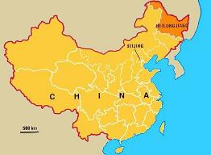
B-CGMS : an old story
1998-99 Pilot project (STEREO-II, BELSPO) aiming to adapt the European Crop Growth Monitoring (CGMS) to Belgian conditions : Birth of B-CGMS
2000-01 CHINE I project: Improvement of B-CGMS and transposition of the system to Heilongjiang province : Birth of H-CGMS
Source : www.technomedia.org

Slide 4
B-CGMS : an old story
1998-99 Pilot project (STEREO-II, BELSPO) aiming to adapt the European Crop Growth Monitoring (CGMS) to Belgian conditions : Birth of B-CGMS
2000-01 CHINE I project: Improvement of B-CGMS and transposition of the system to Heilongjiang province : Birth of H-CGMS
2002-03 CHINE II project: Improvement of H-CGMS
Source : www.technomedia.org

Slide 5




B-CGMS : a Belgian interdisciplinary team
Crop growth monitoring & yield predictions
Remote sensing
= B-CGMS
Meteorological analysis
Meteorological data provider
Source : www.technomedia.org

Slide 6
B-CGMS : a Belgian interdisciplinary team
Crop growth monitoring & yield predictions
Remote sensing
= B-CGMS
Meteorological analysis + bulletins coordination / redaction
New situation from 2019
Meteorological data provider
Source : www.technomedia.org

Slide 7
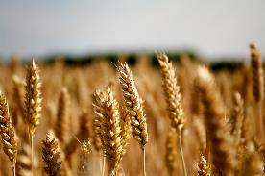
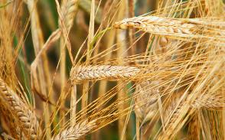
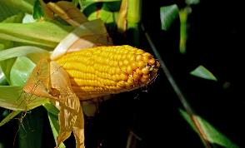
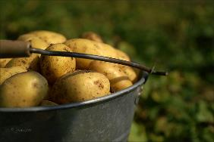
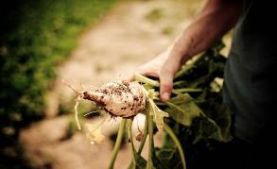
B-CGMS : 5 crops

Slide 8
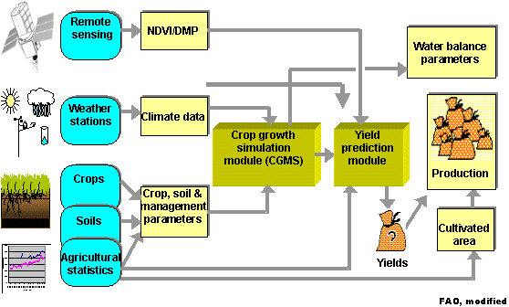

B-CGMS: A system…
Including a crop growth model (WOFOST/CGMS) and… a yield prediction module

Slide 9
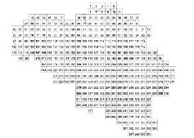
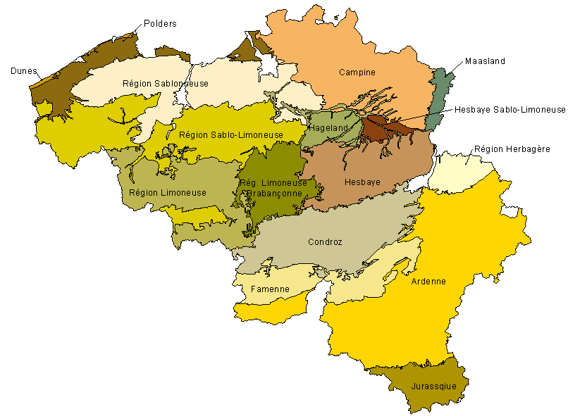
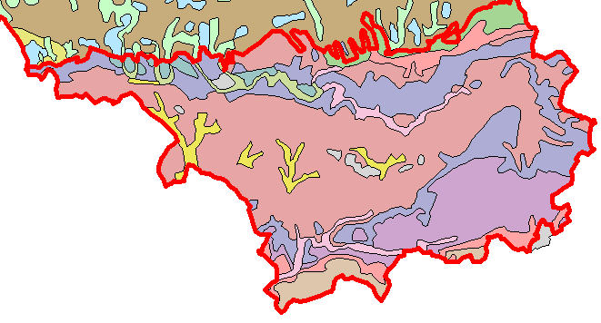
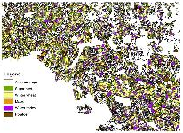
B-CGMS: input data
Meteorological information
Soil information
Mainly hydraulic properties :
  Hydraulic conductivity in staurated soil
  Maximume percolation rate in root zone
  Soil moisture content at saturation / wilting point /field capacity
  Minimum root depth
  …
Soil parameters estimated mainly on the basis of information included in a soil profile database and the use of pedotransfer functions
1 ZP
1 APR
= 4 STU
Regional pedological associations map
Crop information
Data from the Royal meteorological institute
  Temperatures,
  rainfall,
  Vapour pressure,
  Windspeed,
  Evapotranspiration (3),
  radiation
Interpolation of weather station data (10 x 10 km grids)
Agricultural crop maps (suitability)
Agricultural and phenological data:
  Emergence, heading/flowering date, maturity…dates
  Optimum daylength for development
  Maximum relative increase in LAI
  Light use efficiency of a single leaf
  …

Slide 10
B-CGMS: Crop yields prediction module
Combination of linear regression models
Including different categories of yield indicators
Official yield= f (trend) + f (B-CGMS) + f (RS) + f (meteo)
PYB
PYS
WLYB
WLYS
Potential yield in biomass
Potential yield of storage organs
Water-limited yield in biomass
Water-limited yield of storage organs
PX915
OX915
MJ1618
PX2226
NDVI(x)
---
FROST2
Slope of DMP between decades 9 and 15 (growing phase)
Intercept of DMP between decades 9 and 15 (growing phase)
Median of DMP between decades 16 and 18 (June)
Slope of DMP between decades 22 to 26 (decreasing phase)
NDVI value for decade x
…
Number of frosty days from 1st December to 31 March
(only for Winter crops)

Slide 11
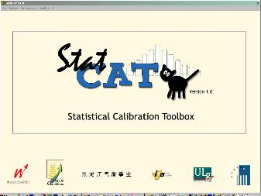
B-CGMS: Crop yields prediction module
Combination of linear regression models
Including different categories of yield indicators
Semi-automated procedure (StatCaT)
Setting-up of yield indicators (at the selected administrative level)
Calibration and selection of models
Validation (production of reports)
Still version 1.0…
No graphical interface for exploring data and analysing results

Slide 12
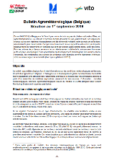
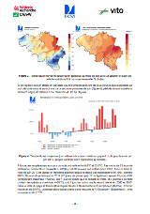
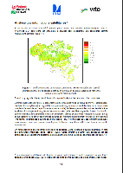

B-CGMS Bulletins
Since 2002 (not financed)
3 publications per year (early May, end of June, early September) – FR and NL
Different chapters :
  Meteorological (growing) conditions
  RS-based monitoring of crops development
  Field-based observation of crops development (pilot/technical centers)
  Yield predictions (June and September)
Distributions through e-mail to 250 national and European recipients such as farmers,(EO and agricultural) researchers, public institutions, private companies or the agricultural press.
Main results are also published in ‘Boer&Tuinder’ (~16-17000 copies distributed weekly

Slide 13
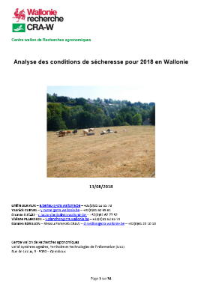

B-CGMS Bulletins – Special bulletins in case of EWE
Only for drought events up to now (2018, 2019)
Realised by CRA-W only upon regional administration request for Wallonia,
Context: request to DG AGRI for a derogation aiming at increasing advance payments for farmers (1st and 2nd CAP pillar)

Slide 14
B-CGMS Bulletins – Satisfaction survey (2014)
Survey sent to 110 persons
Answer rate : 20% (14 FR, 8 NL)
Interest for the different parts :
  Meteo (20 over 22)
  Yield predictions (19 over 22)
  Remote sensing (16 over 22)
Use of the bulletins
  Decision making
  Search for objective informations
3 bulletins per year is enough
Ways of improvement :
  Extension to other crops
  Better layout
  More data coming from farmers, regional differences should more stressed
  Dynamic web portal
Avg. = 8,41

Slide 15

Forthcoming activities - BCGMSweb
DISSUP project funded by BELSPO (6 months, 30k €) – partners : VITO & IRM/KMI – End : 08/2020
Development of an interactive webplatform providing additional and “customized” information to the BCGMS bulletin readers:
  zoom in on specific regions or crops
  Explore other types of maps and graphs than the ones presented in the (static) bulletin (e.g. crop calendars or crop yield statistics).
The user will be able to visualize meteo and satellite derived maps and graphs at different scales (e.g. municipalities, provinces, agricultural regions, NUTS 1 and 0) :
  Visualisation of the products will be user-configurable (e.g. selection of the length of the displayed time series) and will include benchmarking functionalities (e.g. comparison with long-term averages).
  Some products will also be downloadable.

Slide 16
Forthcoming activities - BCGMSweb
Available products
The B-CGMS bulletins (in pdf) + functionalities to suscribe mailing list
Agrometeorological indices characterising the crop growing conditions
Remote sensing data characterising crop growth and development. Time series of biophysical variables (fAPAR, DMP, NDVI) derived from SPOT-VGT/PROBA-V satellite data as well as anomaly maps (differences to long-term average) and phenological indicators (start, progress of the season,...) will be available in the form of maps and graphs. These data are provided by VITO. The users will be able to retrieve information at different geographical scales and for user-defined periods. Provided information will be ‘cropland’ specific and will rely on an updated crop mask derived from the IACS data of the last 5 years.
Yield data. Yield data include official yields at the level of the agricultural regions (from statbel) as well as yield predictions coming from B-CGMS.
Phenological data – Crop calendars

Slide 17

Forthcoming activities - BCGMSweb
Different types of agrometeological indices can be identified :
Temporal aggregation of observed / calculated meteorological data (e.g. sum of rainfall / sum of effective temperatures / average of mean temperatures…) over a given period – example : Sum of rainfall from the 1st October to the 15th of November
Occurrence (nb of days) of a given meteorological event (e.g.number of summer / frost/ winter days) over a given period – Example : number of winter days from the 1st December to 30th of March
More complex (model-based) indicators – Example : number of days in (sub-)optimal and/or critical conditions during the winter wheat growing season.
Return periods of a given meteorological event – Example : return period of having 250 mm of rainfall during the 1st of October and the 15th of November

Slide 18
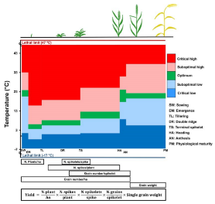
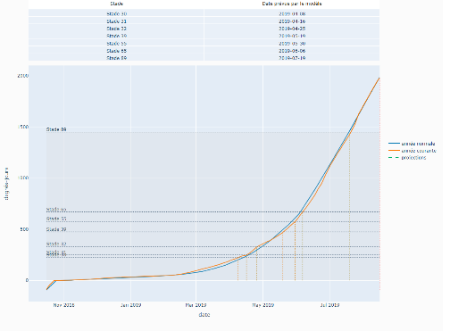
Forthcoming activities - BCGMSweb
Example based on Agromet’s phenological development model
Nb of days in optimal, sub-optimal, critical high conditions (based on a default SOS or user defined date).

Slide 19
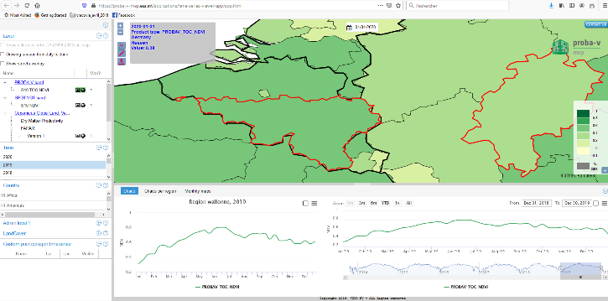
Forthcoming activities - BCGMSweb
Proba-V MEP (Mission Exploitation Platform),

Slide 20
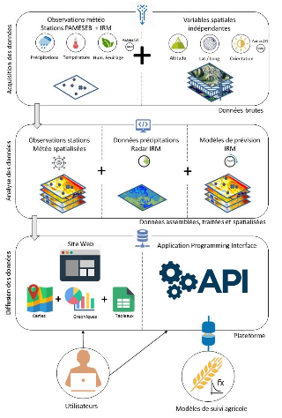
Webplatform (Agromet)
Agromet : setting-up of webplatform (avril 2020) for the dissemination in real-time of high spatial (1km²) and temporal (hourly) resolution agro-meteorological data
Context :
European directive 2009/128/CE constraining member states to set up tools for a rational use of phytosanitary products
Crop warming systems (based on pests & diseases monitoring models) could be one of these tools
These models are underused considering the difficulty to have reliable high spatial (at parcel level) and temporal resolution meteorological data.

Slide 21
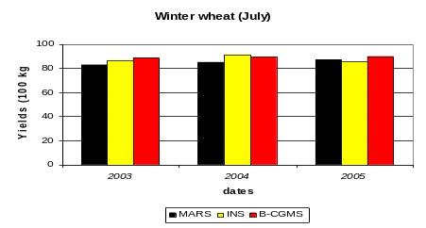
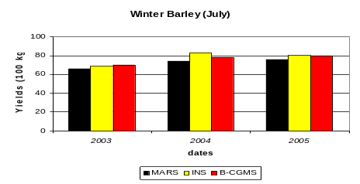
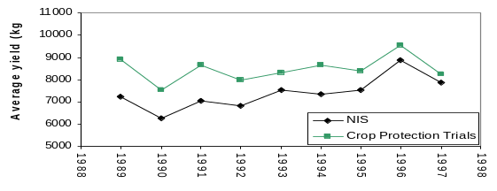

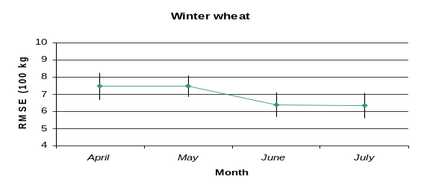
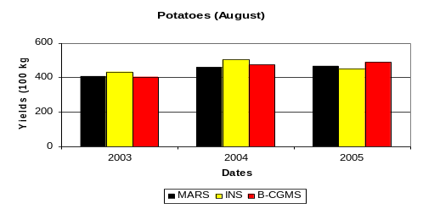
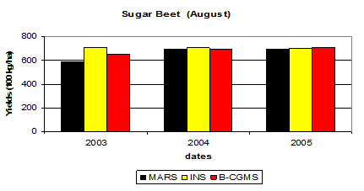
Forthcoming activities – Assesment/improvement of yield predictions
First evaluation done in 2006 (III CGMS experts meeting) → a new one for 2020 would be relevant
Winter wheat
Curnel et al., 2006. The B-CGMS project : evaluation after 5 years of monitoring and prediction. III CGMS Experts meeting and GEOLAND training workshop, Arlon (Belgium), 23-25 October 2006

Slide 22
Forthcoming activities – Assesment/improvement of yield predictions
First evaluation done in 2006 (III CGMS experts meeting) → a new one for 2020 would be relevant
Updated crop mask
  Suitability maps
  Crop group (PROBA-V) or possibly crop specific RS data (Sentinel-2)
Better consideration of inter-regional differences of phenology
Assessment of the use as input of the high spatial (1km²) resolution agro-meteorological data produced by AGROMET
Assimilation technique ? (e.g. de Wit et al., 2012)
New techniques ? e.g. similarity analysis
(Compilation of the 3 bulletins per year – Global analysis of the year)

Slide 23
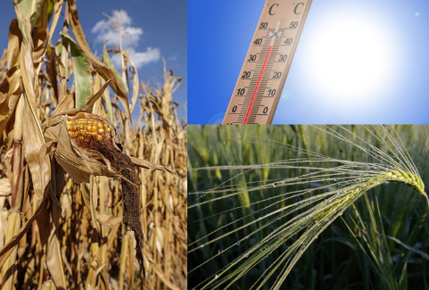
Thank you for your attention !

