Slide 1

Agriculture Monitoring Using Sentinel Images
Emilie Beriaux (CRA-W), Béatrice Leteinturier (SPW), Cozmin Lucau-Danila (CRA-W), Alban Jago (CRA-W), Viviane Planchon (CRA-W)
Copernicus4regions webinar: « How Copernicus helps Europe’s regions to innovate public administration and the delivery of public policies »
3 February 2022
Notes:
My name is Emilie Beriaux. I work at the Wallon Agricultural Research Center. I am going to present the work of my colleagues and myself about Agricultural Monitoring using Sentinel images. This is the work of both Wallon Agricultural Research Center and the Wallon Paying Agency..

Slide 2
The challenge: continuous crop monitoring over all Wallonia (Belgium) to process farmers’ CAP aids
CAP – towards Check by Monitoring & Area Monitoring System
from a compliancy system to a performance system
from a sanction system to a warning system (involving more communication between Paying Agency and farmers)
to reduce the administrative burden of both Paying Agency and farmers
New needs → continuous crop monitoring
Specifics objectives reachable with RS
Change of parcel delineation detection
Ineligible crop/elements detection
Crop type mapping
Agricultural practice detection
Notes:
The Walloon Paying Agency, managing different schemes relating to the common agricultural policy, is in charge of evolving toward the new check by monitoring & Area Monitoring systems. This evolution of the policy aims at moving from a compliancy system to a performance system and involves a continuous crop monitoring in order to process the farmers payments.
One of the main task to evolve to the Check by monitoring system is to define Specific and useful objectives reachable thanks to the existing technologies.

Slide 3
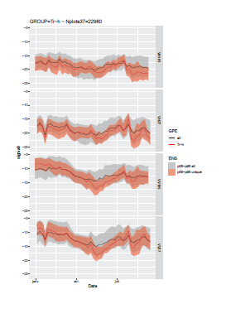
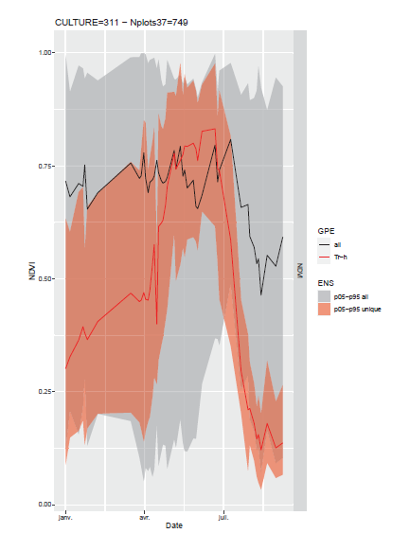
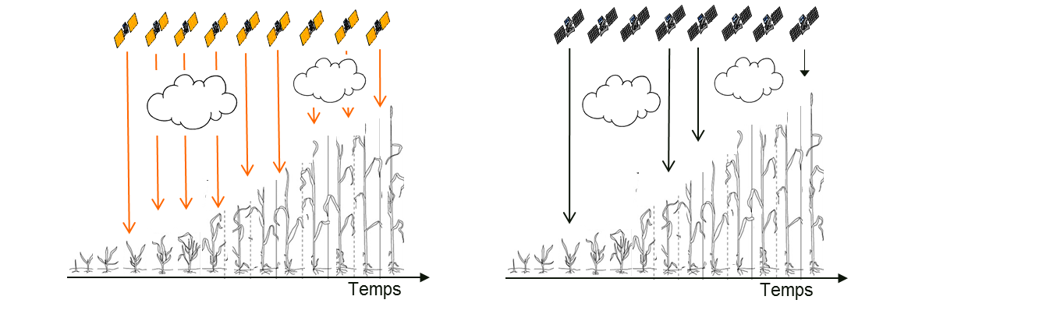
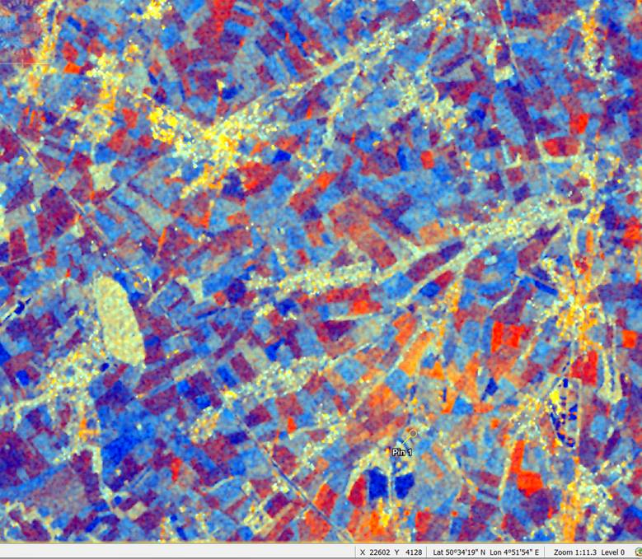
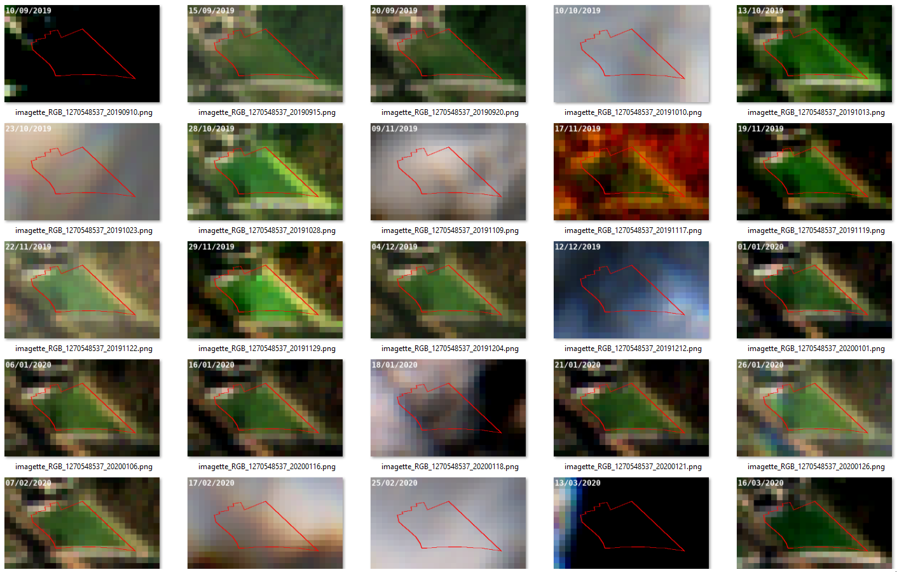

Relevance of Sentinel-1 and Sentinel-2 time series
Time series of indices or signals extracted from both Sentinel-1 and Sentinel-2 images at parcel level allows to generate crop maps, to detect ineligible elements, evolution of plots delineation and agricultural practices.
to detect ineligible elements, multi-covers and agricultural practices.
Sentinel-1 (SAR)
Sentinel-2 (optical)
S-1 & S-2 time series
Crop type map
Changes in parcels delineation
Agricultural practices detection
Ineligible elements detection
Destruction of cover ~harvest
Mowing
Bare soils ~tillage
time
time
Notes:
In this context, the COPERNICUS program offers really useful data in order to continuously monitor the agriculture over all Wallonia.
Indeed, the EO Copernicus Program provides high resolution Sentinel-1& Sentinel-2 satellite imagery.
The Walloon region is covered by a 2–5 days revisit period for Sentinel-2 sensors and a 2 days revisit period for Sentinel-1 sensors.
High temporal and 10-20 m resolution imagery allows to monitor over the time agriculture at parcel level in most of the Walloon fields.
More specifficaly, Time series of indices or signals extracted from both Sentinel-1 and Sentinel-2 images at parcel level allows to generate crop maps, to detect ineligible elements, evolution of plots delineation and agricultural practices.

Slide 4

Evolution of the story
2 new objectives :
From research to final users (Paying Agency and farmers)
Specifics objectives reachable with RS
Change of parcel delineation detection
Ineligible crop detection
Crop type mapping
Agricultural practice detection – mowing, harvest, tillage
Urban elements detection (research in progress)
Research center
Conceptuali-zation & Validation
Paying Agency
Automatization & Operational use
farmers
Changes in Aids Application
Notes:
Our story evolves.
Two new objectives have been defined since the beginning of our story: the identification of agricultural practices such as mowing, cover destruction and bare soil (tillage) detection and the urban elements detection inside agricultural parcels.
Moreover, our story evolves from research to an operational use. Thus, the methods developed and validated by researchers, are then automated and used operationnaly by the Paying Agency who shares to the farmers useful information when they apply for their Aids.

Slide 5
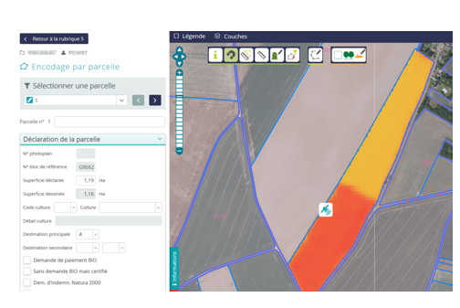
Achievement
Both Sentinel-1 and 2 data are used to generate crop maps, to detect changes and identify agricultural practices in agricultural parcels.
The compilation of each Sentinel-derived product is implemented in the Walloon Paying Agency in the framework of the new Check by Monitoring system. The entire chain runs continuously during the subsequent crop seasons.
Ex. of Achievement:
Change of parcels delineation detection
The research results lead to a tool used by the farmers on their Geo- Spatial Aid Application
Notes:
To conclude:
Both Sentinel-1 and 2 data are used to generate crop maps, to detect changes and identify agricultural practices in agricultural parcels.
The compilation of each Sentinel-derived product is implemented in the Walloon Paying Agency in the framework of the new Check by Monitoring system of the CAP. The entire chain runs continuously during the subsequent crop seasons.
You can see on the slide an exemple of achievement. The research results leads to a tool used by the farmers on their Geo-spatial Aid Application: the new delineation of a field appears automaticcaly while the farmer applies for his aids.

Slide 6
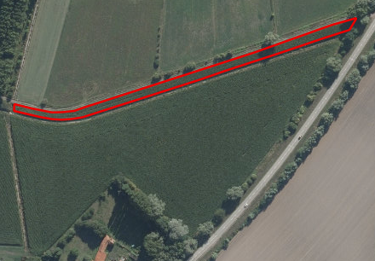
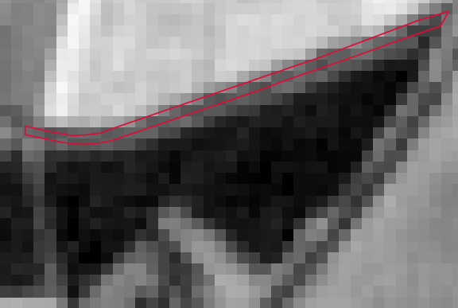
For the future
Improving the quality of the results is still a challenge, especially in the small parcels. To address this issue, other EO data should be used jointly with Sentinel-1 and -2 images, such as aerial photos or very high spatial resolution satellite imagery.
Other products should be achieved to monitor additional schemes, e.g. from the second Pilar.
Orthophoto 2019
S2 NDVI 21/01/2019
Notes:
And for the future:
Improving the quality of the results is still a challenge, especially in the small parcels. To address this issue, other EO data should be used jointly with Sentinel-1 and -2 images, such as aerial photos or very high spatial resolution satellite imagery. We can see on the slide that in some small parcels, no sentinel pixel2 falls entirely within the polygon.
Other products should be achieved to monitor additional schemes, notably schemes from the second Pilar.

Slide 7
THANK YOU !
Emilie Beriaux
e.beriaux@cra.wallonie.be
0032 (0) 485 47 67 56
Beatrice Leteinturier
Beatrice.leteinturier@spw.wallonie.be
Cozmin Lucau-Danila
c.lucau-danila@cra.wallonie.be
Alban Jago
a.jago@cra.wallonie.be
Viviane Planchon
v.planchon@cra.wallonie.be
Agriculture, territory and technologies integration Unit
www.cra.wallonie.be/en/agriculture-territory-and-technologies-integration-unit

