Slide 1



Walloon Agricultural Research
Centre
Resilience of contribution to food security of specialized Walloon dairy systems
C. Battheu-Noirfalise^{1,2}, E. Froidmont¹, D. Stilmant¹, Y. Beckers²
¹Walloon Research Centre, Libramont, Belgium
²Gembloux Agro-Bio Tech, Gembloux, Belgium

Slide 2


Introduction
Food security
Access
Utilization
Stability
Availability
Reaction to food insecurity crisis around the globe → increase productivity of agricultural systems
The four interconnected dimensions of food security
Walloon Agricultural Research Centre
To address today’s questions and to prepare tomorrow’s challenges
www.cra.wallonie.be

Slide 3

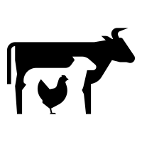

Introduction
Gross productivity
Food
Limiting factors of food production by animals :
Agricultural area
Limiting factors of food production by animals :
Human-edible feed
Non human-edible area
Human-edible Feed
Feed
Area
$$Gross productivity :\frac{Human Edible Protein}{Total Area}$$
Walloon Agricultural Research Centre
To address today’s questions and to prepare tomorrow’s challenges
www.cra.wallonie.be

Slide 4
Introduction
(Battheu-Noirfalise et al. 2023)
https://doi.org/10.1007/s13593-023-00901-z
Net productivity
Food
Limiting factors of food production by animals :
Human-edible feed
Non human-edible area
Feed
Area
$$Net productivity :\frac{Human Edible Protein −Human Edible Feed}{Non−Human Edible Area}$$
Walloon Agricultural Research Centre
To address today’s questions and to prepare tomorrow’s challenges
www.cra.wallonie.be

Slide 5
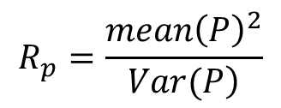
Introduction
Resilience of production
Access
Utilization
Stability
Availability
(Zampieri et al. 2020)
https://doi.org/10.1016/j.scitotenv.2020.139378
Resilience of production
$$R_{p}=\frac{{mean\left(P\right)}^{2}}{\left.Var(P\right)}$$
The four interconnected dimensions of food security
Walloon Agricultural Research Centre
To address today’s questions and to prepare tomorrow’s challenges
www.cra.wallonie.be

Slide 6
Objectives
Analyse the resilience of contribution to food security of dairy systems
  H : intensive systems have lower resilience of net productivity ~ fixed requirement in rich feeds of high productive cows
Compare the results of gross and net productivity
  H : net productivity has lower resilience than gross productivity ~ lower mean value
Study the influence of the end of milk quotas
  H : resilience of both metrics will decrease after the end of milk quotas ~ destabilization of the market + farms will increase intensification to cope with open market prices
Walloon Agricultural Research Centre
To address today’s questions and to prepare tomorrow’s challenges
www.cra.wallonie.be

Slide 7
Results
 | IG | IM | EG
Number of farms | 29 | 16 | 34
Milk production per cow (kg FPCM cow⁻¹ year⁻¹) | 7580 a | 7670 a | 5480 b
Grassland yield (t DM ha⁻¹) | 9.3 a | 7.8 b | 7.3 b
Percentage of maize silage (%) | 6 b | 38 a | 9 b
Concentrates per cow (kg DM cow⁻¹ day⁻¹) | 4.8 a | 4.2 a | 2.3 b
CP-content of concentrates (%) | 19.8 b | 26.3 a | 19.8 b
Stocking rate (LU ha⁻¹) | 2.33 a | 2.62 a | 1.69 b
Age at first calving (months) | 29.2 b | 30.3 b | 33.6 a
Female followers per cow (cow⁻¹) | 0.75 b | 0.88 a | 0.63 c
7580 a | 7670 a | 5480 b
Farm types
7580 a | 7670 a | 5480 b
6 b | 38 a | 9 b
4.8 a | 4.2 a | 2.3 b
19.8 b | 26.3 a | 19.8 b
6 b | 38 a | 9 b
4.8 a | 4.2 a | 2.3 b
19.8 b | 26.3 a | 19.8 b
Dataset :
FADN data
79 dairy farms
10 years (2011-2020)
Definition of farm types :
Kmeans clustering on the PCs
On the mean of the years
IG : Intensive Grass
IM : Intensive Maize
EG : Extensive Grass
Mean of the 10 years
 | IG | IM | EG
Gross productivity (kg HDP ha⁻¹) | 302 +/- 52 a | 301 +/- 68 a | 199 +/- 51 b
Net productivity (kg HDP ha⁻¹) | 269 +/- 56 a | 231 +/- 62 b | 183 +/- 50 c
Resilience of gross productivity () | 80.9 a | 53.3 b | 48.5 c
Resilience of net productivity () | 52.8 a | 20.5 c | 42.9 b
Walloon Agricultural Research Centre
To address today’s questions and to prepare tomorrow’s challenges
www.cra.wallonie.be

Slide 8
Results
Influence of milk quota regime
 | IG |  |  | IM |  |  | EG
Milk quota | Yes | No | P-val | Yes | No | P-val | Yes | No | P-val
Gross productivity (kg HDP ha⁻¹) | 306 +/- 44 | 298 +/- 50 |  | 297 +/- 51 | 305 +/- 71 |  | 212 +/- 45 | 185 +/- 48 | ***
Net productivity (kg HDP ha⁻¹) | 272 +/- 46 | 266 +/- 53 |  | 236 +/- 41 | 227 +/- 55 |  | 195 +/- 43 | 170 +/- 47 | ***
Resilience of gross productivity () | 92.6 | 90.8 | *** | 63.9 | 56.4 | *** | 56.1 | 49.5 | ***
Resilience of net productivity () | 62.7 | 53.1 | *** | 23.5 | 18.0 | *** | 49.1 | 42.7 | ***
>
>
>
>
>
>
>
>
All farm types show a lower resilience of both gross and net productivity after the end of milk quotas :
- IG and IM ~ Variability
- EG ~ Mean value
Walloon Agricultural Research Centre
To address today’s questions and to prepare tomorrow’s challenges
www.cra.wallonie.be

Slide 9
Results
Influence of milk quota regime
 | IG |  |  | IM |  |  | EG
Milk quota | Yes | No | P-val | Yes | No | P-val | Yes | No | P-val
Milk production per cow (kg FPCM cow⁻¹ year⁻¹) | 7490 | 7660 | * | 7470 | 7870 | *** | 5530 | 5440
Fodder yield correction (%) | 117 | 115 |  | 92 | 102 | *** | 92 | 91
Percentage of maize silage (%) | 7 | 5 |  | 39 | 38 |  | 10 | 9
Concentrates per cow (kg DM cow⁻¹ day⁻¹) | 4.6 | 5.0 | ** | 4.0 | 4.4 | * | 2.4 | 2.2
CP of concentrates (%) | 20.4 | 19.3 | * | 26.0 | 26.5 |  | 20.1 | 19.4
Stocking rate (LU ha⁻¹ farm⁻¹) | 2.39 | 2.26 | *** | 2.56 | 2.67 |  | 1.75 | 1.62 | ***
Age at first calving (months) | 29.2 | 29.2 |  | 30.8 | 29.7 | * | 33.0 | 34.3 | ***
Female followers per cow (cow⁻¹) | 0.75 | 0.75 |  | 0.94 | 0.83 | *** | 0.58 | 0.69 | ***
<
<
>
>
<
<
>
>
>
<
<
Farm types show specific evolution pathways :
- IG and IM show an intensification
- EG shows an extensification
Walloon Agricultural Research Centre
To address today’s questions and to prepare tomorrow’s challenges
www.cra.wallonie.be

Slide 10
Discussion
Analyse the resilience of contribution to food security of dairy systems
  H : intensive systems have lower resilience of net productivity ~ fixed requirement in rich feeds of high productive cows
  The intensive and grass-based type (IG) shows the highest mean levels of net productivity and resilience of net productivity → IG can couple the dimensions availability and stability of food security
  Although the intensive maize based type has a higher mean level of net productivity, its resilience of net productivity is lower than the extensive grass-based type
Compare the results of gross and net productivity
  H : net productivity has lower resilience than gross productivity ~ lower mean value
  Net productivity show lower resilience ~ lower mean value than gross productivity
Study the influence of the end of milk quotas
  H : resilience of both metrics will decrease after the end of milk quotas ~ destabilization of the market + farms will increase intensification to cope with open market prices
  The period after the end of milk quotas (> 2015) is associated with lower resilience. However, five years is a short period, that can also be influenced by other factors such as extreme weather events
Walloon Agricultural Research Centre
To address today’s questions and to prepare tomorrow’s challenges
www.cra.wallonie.be

Slide 11
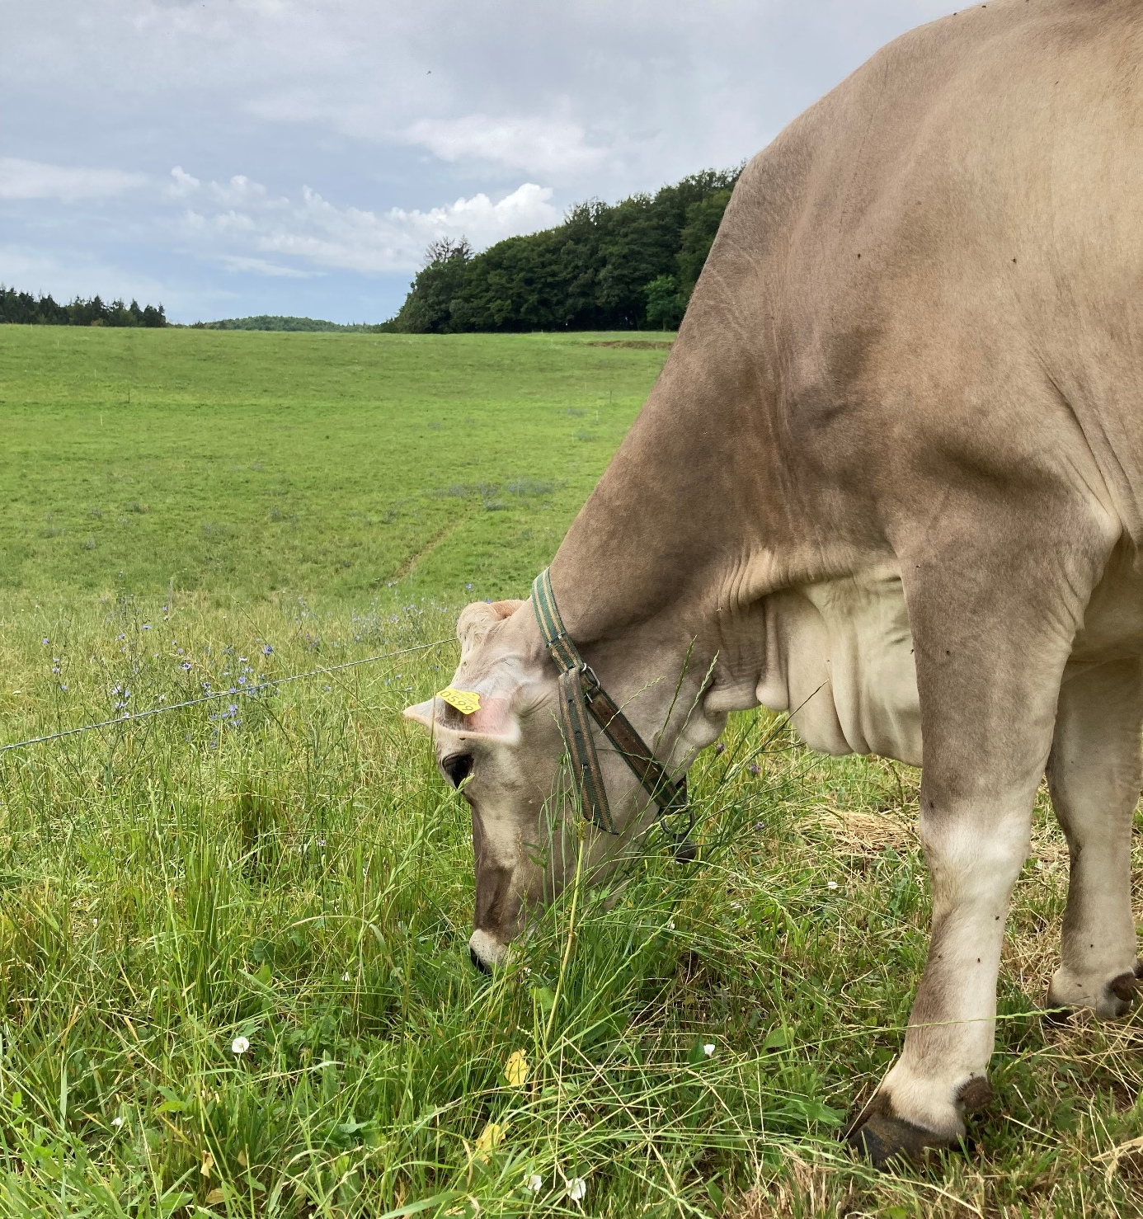

R4D Meeting, Slovenia.
Easily said, …
Hardly done.
Valorize grass !

