Slide 1
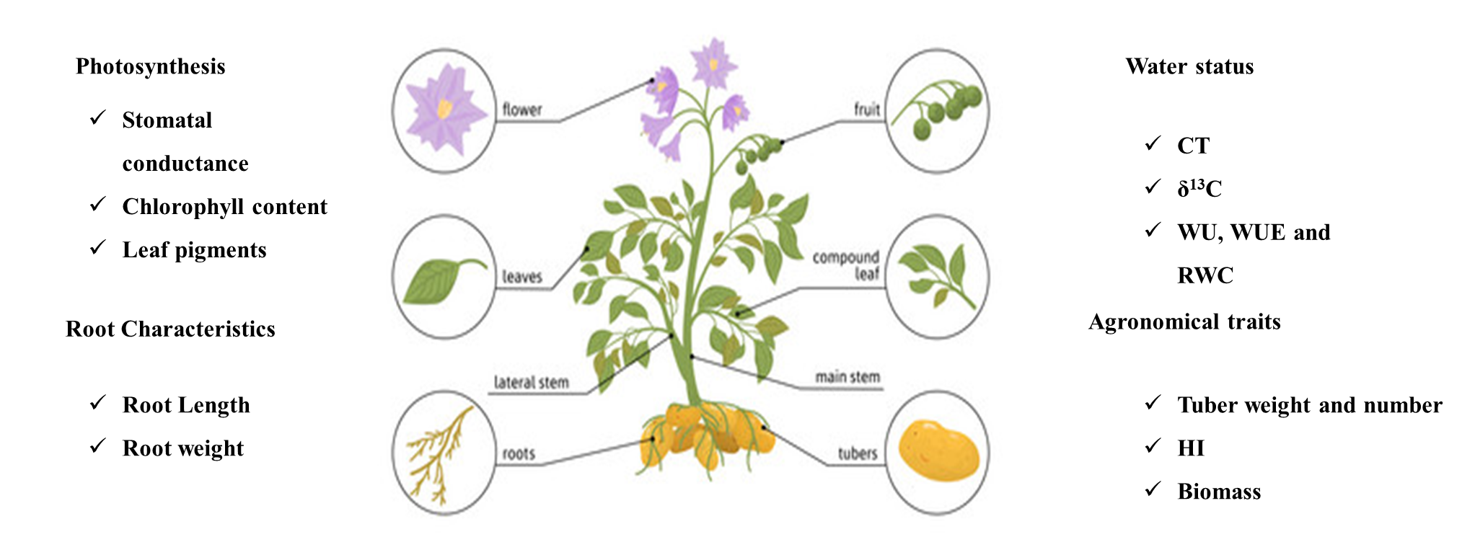
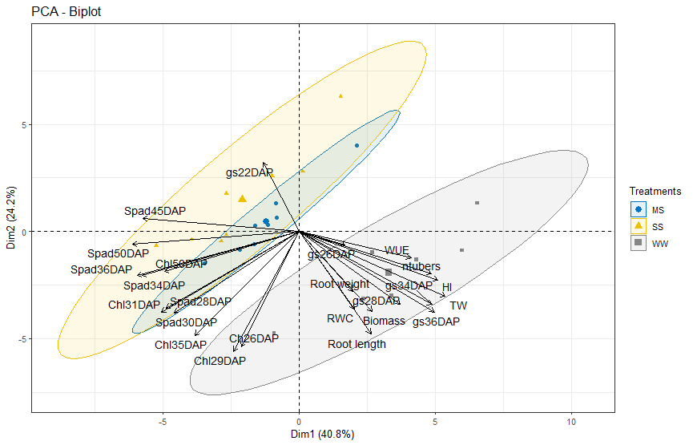
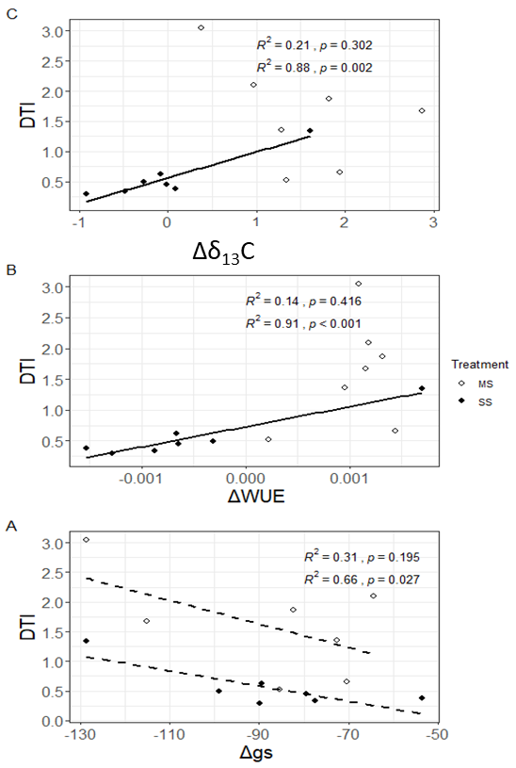
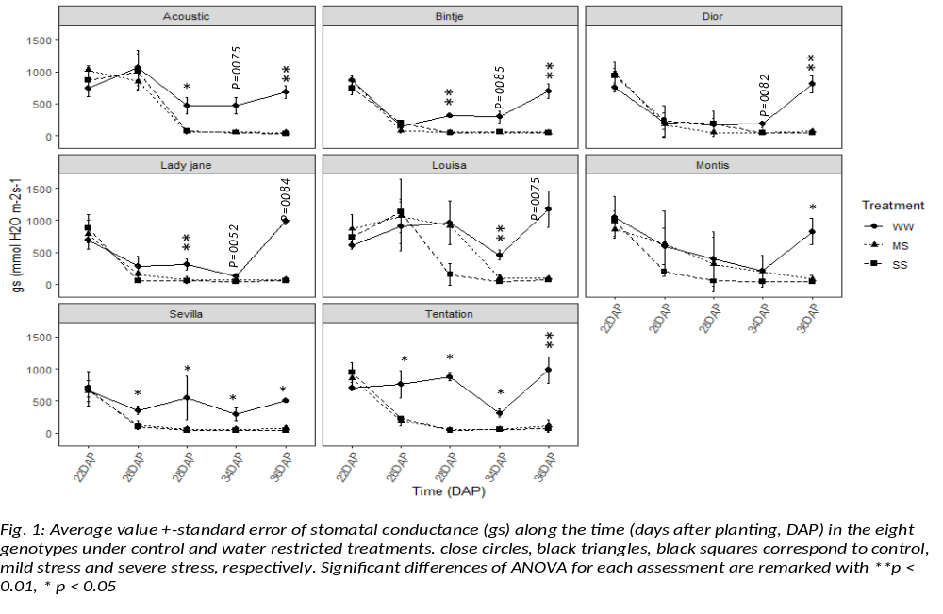
Responses of potato cultivars to water stress condition
under greenhouse: Agronomical and Physiological
parameters
CHAIRI F, HOUCHARD L, BOREUX M, LOUIS O, STOEFS D
Walloon Agricultural Research Center – Life science Department - Belgium
E-mail: f.chairi@cra.wallonie.be
Introduction
Potatoes are particularly sensitive to water stress conditions, which can significantly impact their yield and quality.
This study examines the responses of different potato cultivars under greenhouse conditions, focusing on agronomical and physiological parameters. Specifically, we measured water use (WU, WUE), stomatal conductance, canopy temperature, and isotopic signatures. The results will provide crucial insights for improving agricultural practices under water stress challenges.
Materials and Methods
Table 1: Mean values for Tuber weight, crop growth and root parameters of eight potatoes cultivar under different water regimes (WW, full irrigation, MS, Mild water stress, WS, severe water stress). Means followed by different letters were significantly different by Tukey’s b test.
Eight potato varieties
Greenhouse condition in the CRAW Facilities at Libramont
Three treatment -Well watered
-Mild stress
-Severe stress
Measurements: Photosynthetic and water status parameters; Root characteristics and Agronomical traits (see Fig. 1)
Laboratory analysis: C stable isotope
 |  | Tuber weight (g plant⁻¹) | nTubers | Biomass (g plant⁻¹) | Plant height (cm) | nStem | HI (%) | Root length (cm) | Root weight (g plant⁻¹)
Genotype | Acoustic | 115.56^{abc} | 11.00^{abc} | 19.98^{bc} | 47.22^{d} | 3.56^{c} | 5.04^{b} | 62.33ª | 4.93^{c}
 | Binjte | 114.44^{abc} | 14.56ª | 21.77^{b} | 54.33^{c} | 6.00^{b} | 4.60^{b} | 42.78de | 6.22^{bc}
 | Dior | 122.56^{ab} | 10.89^{abc} | 21.38^{b} | 53.22^{c} | 5.33^{bc} | 5.09^{b} | 39.56e | 6.64^{b}
 | Lady jane | 94.11^{bcd} | 8.22^{bc} | 23.16^{b} | 61.44^{b} | 3.44^{c} | 3.62^{b} | 56.89^{abc} | 5.81^{bc}
 | Louisa | 86.78^{cd} | 9.56^{bc} | 21.15^{b} | 66.00ª | 4.11^{bc} | 3.75^{b} | 51.00^{bcd} | 4.97^{c}
 | Montis | 34.22e | 3.56^{d} | 28.40ª | 52.33^{c} | 3.78^{c} | 0.83^{c} | 55.89^{abc} | 6.48^{b}
 | Sevilla | 64.67^{d} | 6.44^{cd} | 31.33ª | 51.56^{c} | 8.78ª | 1.84^{c} | 59.06^{ab} | 10.19ª
 | Tentation | 143.11ª | 11.33^{ab} | 17.46^{c} | 46.33^{d} | 4.56^{bc} | 7.72ª | 46.72^{cde} | 3.20^{d}
Treat | WW | 218.92ª | 15.08ª | 30.06ª | 56.46ª | 4.88 | 8.30ª | 63.54ª | 7.66ª
 | MS | 52.83^{b} | 7.75^{b} | 20.72^{b} | 48.83^{b} | 4.88 | 2.80^{b} | 48.54^{b} | 5.78^{b}
 | SS | 19.04^{c} | 5.50^{c} | 18.47^{c} | 49.21^{b} | 5.08 | 1.09^{c} | 43.25^{b} | 4.72^{c}
ANOVA | G | 0.000 | 0.000 | 0.000 | 0.000 | 0.000 | 0.000 | 0.000 | 0.000
 | T | 0.000 | 0.000 | 0.000 | 0.000 | ns | 0.000 | 0.000 | 0.000
 | G * T | 0.000 | ns | 0.000 | ns | ns | 0.001 | ns | 0.003
DISCUSSIONS AND CONCLUSION
The PCA analysis (Fig. 1) distinguished water deficit treatments (control, moderate, and severe drought) and genotypes based on PC1 (40.8%) and PC2 (24.2%). Root length, root weight, RWC, WUE, HI, gs (measured on 26, 28, 34, and 36 DAP), tuber weight, and tuber number were positively correlated with unstressed control plants. In contrast, SPAD values at various dates were associated with water deficit treatments.
All varieties closed significantly stomata under stress, although some closed stomata more drastically than others being Tentation and sevilla that closed stomatal early at 26DAP (Fig .2).
-> Potato avoid the water losses through a tight or better stomatal control of transpiration under water stress and an increased WUE
The negative correlation between the variation of the stomatal conductance and Drought tolerance index (DTI) and the positive correlation between the variation of WUE, δ¹³C and DTI (Fig. 3) suggest that even closing stomata plant have been able to fix CO₂ .
Fig 1. :Principal component bi-plot scores PC1 vs PC2 showing the clustering of well-watered, mild stress and severe stress plants, and the contribution of various traits to the variation in the dataset at different DAP. The traits are TW (Tubers Weight), N tubers (Numbers of Tubers), RL (Root Length), RW (Root Weight), HI (Harvest Index), Biomass, RWC (Relative Water Content), gs (Stomatal conductance) in different days after planting (22-26-28-34-36 DAP), SPAD (Chlorophyll content using SPAD) on different days after planting(28-30-35-45-50), Chl (Chl content using Dualex) on different days after planting(26-29-31-35-50 DAP)c
δ¹³C
Fig. 2 Average value ± standard error of Chlorophyll content (SPAD units) along the time (days after planting, DAP) in the eight genotypes under control and water restricted treatments. Close circles, close triangle and close square correspond to control (WW), mild water stress (MS) and severe stress (SS) treatments. Significant differences of ANOVA for each assessment are remarked with ** p<0.01, * p<0.05.
Fig. 3: Scatter plot for drought tolerance index (DTI) vs average increase / decrease of stomatal conductance (Δgs, A), water use efficiency (ΔWUE, B), carbon isotope composition ( Δδ13C) in relation to the control corresponding to all the genotypes. mild and severe water stress are represented in closed and open circles respectively. Linear functions were fitted only between variables that showed significant (p <0.1) ANOVA of the regression analysis.

