Slide 1
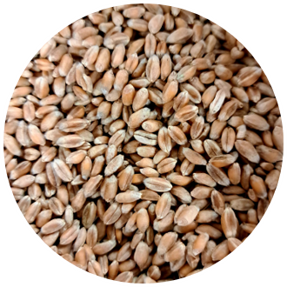
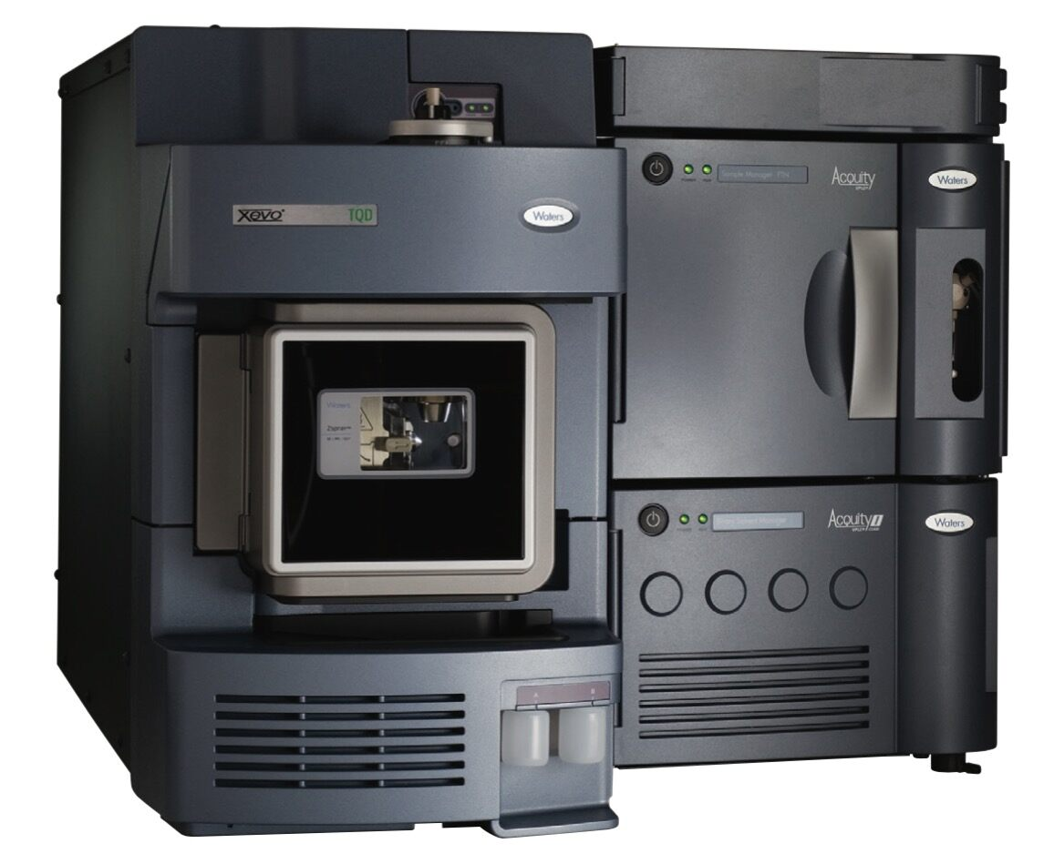
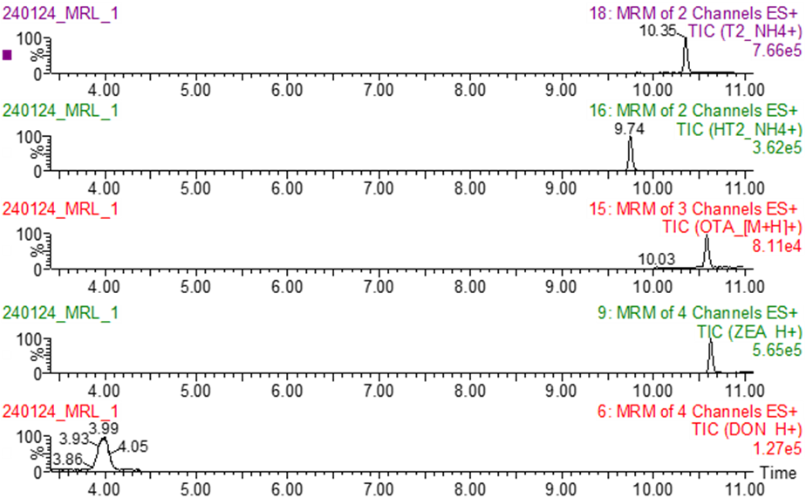
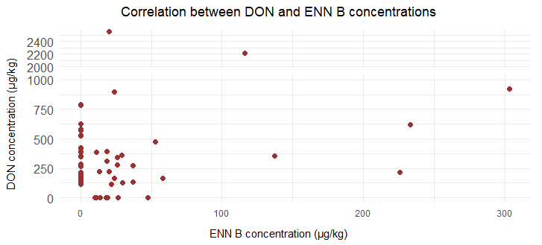
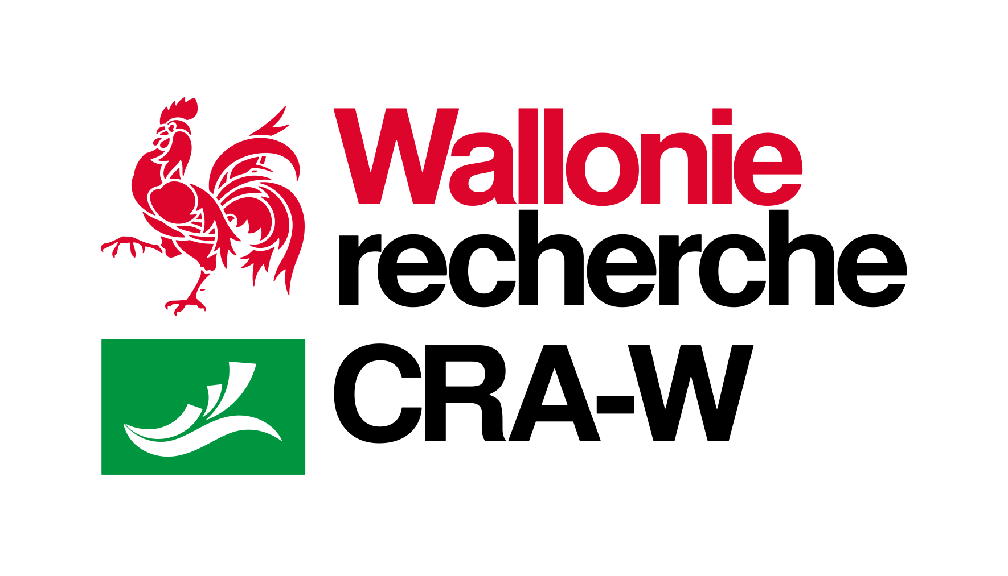
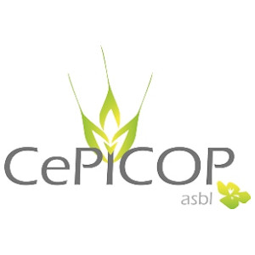





Multi-mycotoxin analyses by UPLC-MS/MS in wheat: Emerging mycotoxins in Wallonia in 2023 and 2024
Jonard C., Chandelier A., Eylenbosch D., Faux A-M., Vermeulen P., Godin B., Gofflot S.
Overview
Analysis of 184 wheat samples from 2023 and 2024 harvests in different locations in Wallonia (Belgium) with a multi-mycotoxin analysis method by UPLC-MS/MS with a focus on emerging mycotoxins. Enniatins were more present in 2024 samples than 2023 samples. At this stage, no clear relationship can be observed between DON and enniatins concentration in wheat samples.
Introduction
The present research is part of a Walloon project “ValCerWal” conducted by the Walloon Agricultural Research Centre (CRA-W) in Belgium. This project aims to increase the valorisation of cereals such as wheat, spelt, etc. for local production to reach industrial and craft quality requirement.
Mycotoxins pose a significant threat to food safety and human health.
This work proposes a review of the emerging mycotoxins detected in wheat in 2023 and 2024 harvests and highlight the link between the conventional and emerging mycotoxins contamination.
Materials and methods
Analysis of 184 wheat samples from 2023 and 2024 harvests
Detection and quantification of mycotoxins in the extracts by UPLC-MS/MS
Grinding and extraction
2023 harvest (n=92),
2024 harvest (n=92)
Multiple Reaction Monitoring
Example of chromatograms
Results
2023 :
  ENN A1 : No contaminated samples
  ENN B : 3 contaminated samples (ranging from 10 to 131 µg/kg)
  ENN B1 : No contaminated samples
2024 :
  ENN A1 : No contaminated samples
  ENN B : 28 contaminated samples (ranging from 11 to 303 µg/kg)
  ENN B1 : 13 contaminated samples (ranging from 10 to 74 µg/kg)
* LOQ for enniatins = 10 µg/kg
No clear relationship between the concentration of DON and ENN B.
Conclusion
Use of an analytical method able to quantify multiple mycotoxins in one analysis
Enniatins more present in 2024 samples than in 2023 samples with enniatin B as the most prevalent
Continuous monitoring of conventional and emerging mycotoxins is relevant as it enables the anticipation of risks, the warning of the sector, and the limitation of contaminated batches entering the processing chains
c.jonard@cra.wallonie.be
Walloon Agricultural Research Centre
To address today’s questions and to prepare tomorrow’s challenges
www.cra.wallonie.be

