Slide 1
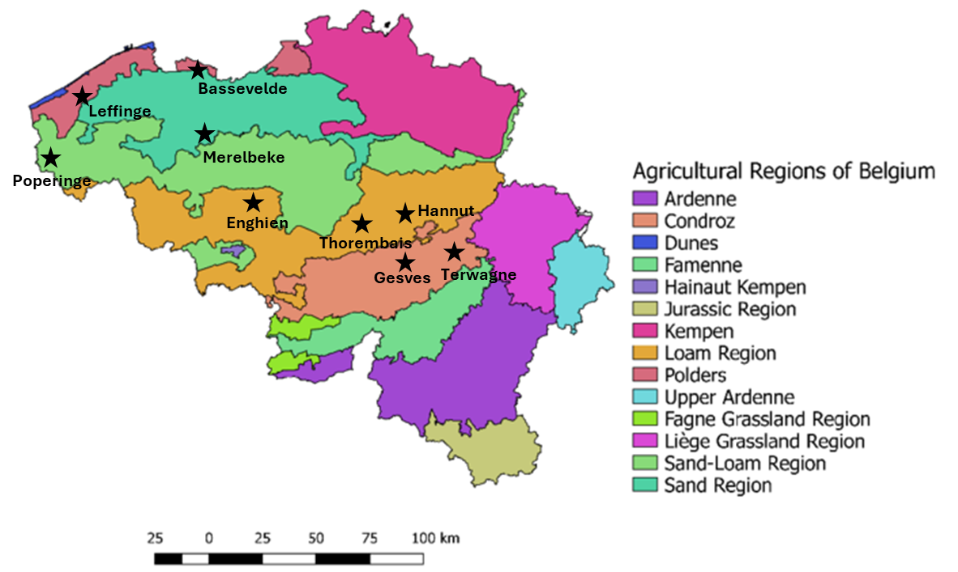
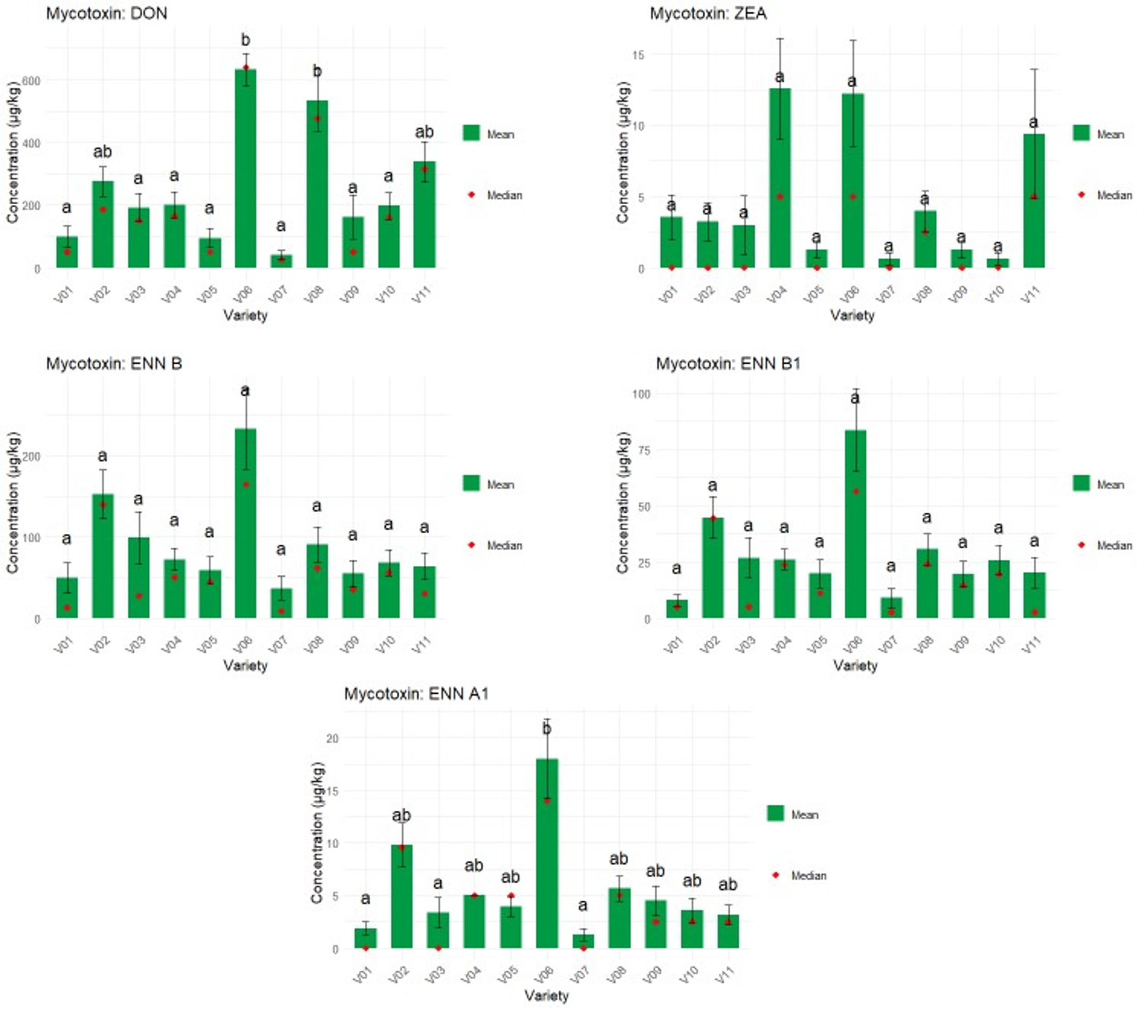
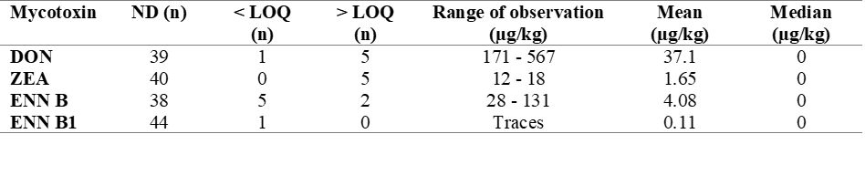
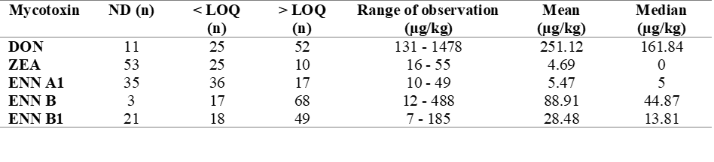
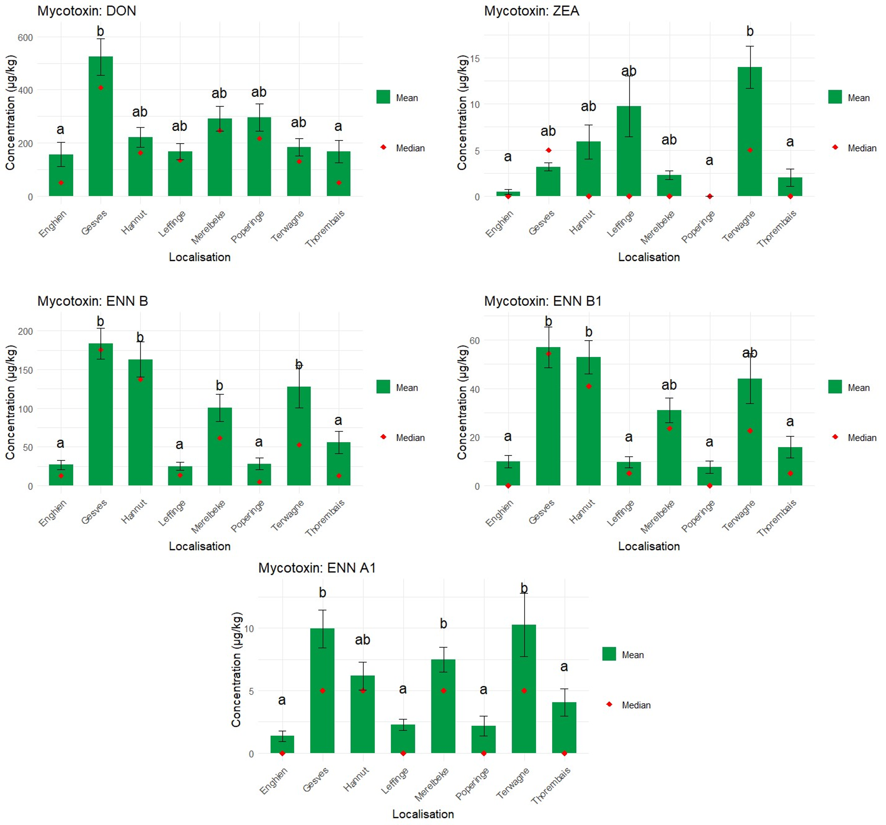






Multi-mycotoxin analyses by UPLC-MS/MS in wheat:
Situation in Belgium in 2023 and 2024
Jonard C. ¹, Chandelier A. ¹, Eylenbosch D. ¹, Pannecoucque J.², Demoitie C. ¹, Godin B. ¹, Gofflot S. ¹
¹ Walloon Agricultural Research Centre, 5030 Gembloux, Belgium
² Research Institute for Agriculture, Fisheries and Food, 9820 Merelbeke-Melle, Belgium
Introduction
The present research is part of a Walloon project “ValCerWal” (funded by the “Walloon Recovery Plan”) conducted by the Walloon Agricultural Research Centre (CRA-W) in Belgium. It aims to increase the added value of cereals such as wheat, spelt durum, barley, for local production to reach industrial and artisanal quality requirement using different sorting technologies.
More precisely, this study aims to give a short overview of the situation in wheat in Belgium in 2023 and 2024. A total of 133 wheat samples from 2023 and 2024 harvests were analysed with a multi-mycotoxin analysis method by UPLC-MS/MS.
Materials and method
2023 harvest : 45 samples from 9 cultivation site
(5 different varieties)
2024 harvest : 88 samples from 8 cultivation site
(11 different varieties)
Multi-mycotoxin analytical method :
Simplified QuEChERS extraction
Injection on UPLC-MS/MS system in a Multiple Reaction Monitoring mode
Variety effect
Detection and quantification of 16 mycotoxins : DON, 3Ac-DON, 15Ac-DON, OTB, OTA, T2, HT2, ZEA, AME , AOH, ENN A, ENN A1, ENN B, ENN B1, FUM B1, and STE
Results
Summary of mycotoxin contamination in 2023 wheat samples
Summary of mycotoxin contamination in 2024 wheat samples
Cultivation site effect
n: number of samples; ND: non-detected; ND were replaced by 0 and < LOQ were replaced by LOQ/2 for the calculation of the mean and the median
LOD (µg/kg): DON (60), ZEA (2.4), ENN A1 ( ); ENN B ( ), ENN B1( )
LOQ (µg/kg): DON (100), ZEA (10), ENN A1 (10), ENN B (10), ENN B1 (10)
Comparison between 2023 and 2024 samples:
Higher mycotoxin occurrence in 2024 compared to 2023, both in terms of number of contaminated samples and contamination levels.
Variety effect:
As part of this trial network, significant variety effect was observed for the contamination levels of DON, ZEA, ENN B1, and ENN A1 (p < 0.05).
Localisation effect:
In this study, location significantly affected mycotoxin presence probably due to specific weather events. Gesves was the most impacted site, with heavy rain and mudflows damaging the crops
The letters were obtained by a Dunn test done following a Kruskall-Wallis test.
Conclusion
The increased prevalence of mycotoxins in 2024 could be attributed to the rainy conditions during the wheat flowering period, which are known to enhance fungal development and toxin production.
Within the framework of this study, some wheat varieties were found to be more susceptible to mycotoxin contamination.
Enniatins were widely found in wheat samples from 2024 harvest.
c.jonard@cra.wallonie.be
Walloon Agricultural Research Centre
To address today’s questions and to prepare tomorrow’s challenges
www.cra.wallonie.be

